Slide 1
5.2 PROJECT - PRESENTATION
Predicting Heart Disease Risk
Using Machine Learning Techniques
Takeria Thomas
Student ID: taktho3199
Notes:
Title slide. Introduce the project: predicting heart disease risk with machine learning, covering EDA, a baseline model, a neural network, scenario analysis, and an interactive dashboard.

Slide 2
THE PROBLEM
Problem & Research Questions
Why it matters
Q1
Which patient characteristics relate most strongly to heart disease?
Heart disease is a leading cause of death. Identifying high-risk patients early from routine clinical measurements supports earlier intervention and better outcomes.
Q2
Does a neural network predict more accurately than a baseline model?
Goal: build and compare models that predict heart disease, then test how the best model reacts to changes in key risk factors.
Q3
How do changes in cholesterol, blood pressure, heart rate, and exercise variables affect predicted risk?
Notes:
State the problem and the three research questions. Q1 is about feature importance, Q2 compares the neural network to the baseline, Q3 is the scenario analysis.

Slide 3
THE DATA
Dataset Overview
UCI Heart Disease Data (Kaggle). Demographic, clinical, and diagnostic measurements for heart-disease screening.
920
16
509 / 411
Binary
patient records
original features
disease / no-disease
classification task
Target: presence of heart disease (1 = disease when severity score num > 0, else 0). The classes are reasonably balanced (~55% / 45%), so accuracy is a fair headline metric.
Key measurements used: age, sex, chest-pain type, resting blood pressure, cholesterol, maximum heart rate, exercise-induced angina, ST depression, number of major vessels, and thalassemia.
Notes:
Describe the dataset: 920 patients, 16 features, a balanced binary target built from the severity score.

Slide 4
EXPLORATORY ANALYSIS
Key EDA Findings
Strongest correlations with heart disease
What stood out
Exercise-induced angina: 84% vs 36% disease rate
Asymptomatic chest pain: ~79% disease rate
Lower max heart rate linked to disease
Cholesterol & resting BP: weak on their own
Notes:
The strongest signals are the number of major vessels, ST depression, and maximum heart rate, plus exercise-induced angina and asymptomatic chest pain. Cholesterol and resting BP are weak alone.

Slide 5
PREPARATION
Data Cleaning & Preprocessing
Missing data 1,759 gaps filled: median (numeric), mode (light categoricals), "Unknown" (heavy).
Bad values Impossible zero cholesterol / BP treated as missing.
1
2
Outliers Capped at 1.5×IQR - no records dropped (920 kept).
Removed id (identifier) and num (reveals the target).
3
4
Encoding & scaling One-hot encoding + standardization → 31 features.
Engineered age_group and chol_level bands added.
5
6
Notes:
Summarize Part 2 preparation: missing-value strategy, impossible zeros, outlier capping, removed columns, encoding/scaling to 31 features, and two engineered features.

Slide 6
MODEL 1
Baseline: Decision Tree
Why a decision tree?
0.766
0.802
Simple and fully interpretable
Handles encoded + numeric features directly
Clear reference point for the neural network
80/20 stratified split (736 train / 184 test)
Accuracy
F1-Score
Key weakness: overfitting
Training accuracy 1.00 vs test 0.766 - the unconstrained tree (depth 17) memorized the training data instead of learning general patterns.
Notes:
The baseline decision tree hits 0.766 accuracy and 0.802 F1 but overfits badly (perfect training accuracy), which motivates the neural network.

Slide 7
MODEL 2
Neural Network
Architecture
0.804
0.827
Input 31 features
Accuracy
F1-Score
Dense 32 neurons - ReLU
Dense 16 neurons - ReLU
Learning & fit
Output 1 neuron - Sigmoid
Accuracy rose and loss fell steadily (the model learns well), with only mild overfitting late in training (train ~0.986 vs validation ~0.811).
Adam optimizer - binary cross-entropy - 100 epochs - batch 16 - 1,569 parameters
Notes:
The neural network reaches 0.804 accuracy and 0.827 F1, learns effectively, and shows only mild late-epoch overfitting.

Slide 8
HEAD TO HEAD
Baseline vs Neural Network
The takeaway
Neural network wins on accuracy, precision, and F1.
Baseline only edges recall (0.853 vs 0.843).
F1 is the key metric – balanced classes, medical context.
NN generalizes better than the tree.
Notes:
Answering Research Question 2: the neural network outperforms the baseline on accuracy, precision, and F1. F1 is the most important metric here.

Slide 9
WHAT-IF ANALYSIS
Scenario Design
Using the neural network to test how predicted risk responds when key inputs change (Research Question 3).
Scenario 1
Scenario 2
Scenario 3
Improved Cardiovascular Health
Worsened Cholesterol & BP
Exercise Stress Present
Change applied:
Change applied:
Change applied:
Max HR +25 bpm, ST depression = 0, no exercise angina
Cholesterol +20%, resting blood pressure +15 mmHg
Exercise-induced angina present, ST depression +1.5
Notes:
Three realistic scenarios: one improvement and two worsening conditions, all built on the exercise, heart-rate, cholesterol, and blood-pressure features from Research Question 3. Same preprocessing as Part 3.

Slide 10
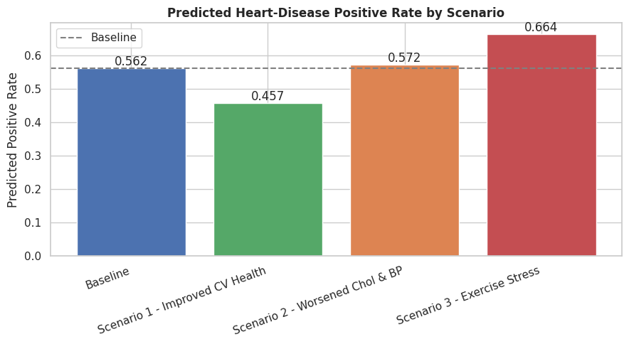
WHAT-IF ANALYSIS
Scenario Results
Baseline: 56.2% predicted disease
Largest drop: Improved CV health → 45.7% (–10.5 pts)
Largest rise: Exercise stress → 66.4% (+10.2 pts)
Smallest change: Chol & BP → 57.2% (+1.0 pt)
Direction matched expectations in every case
Model-sensitivity results – not proof of real-world causation.
Notes:
Exercise and heart-rate scenarios move the model most; cholesterol/BP barely move it. All changes go in the expected direction. Emphasize these are model-sensitivity results, not causal claims.

Slide 11
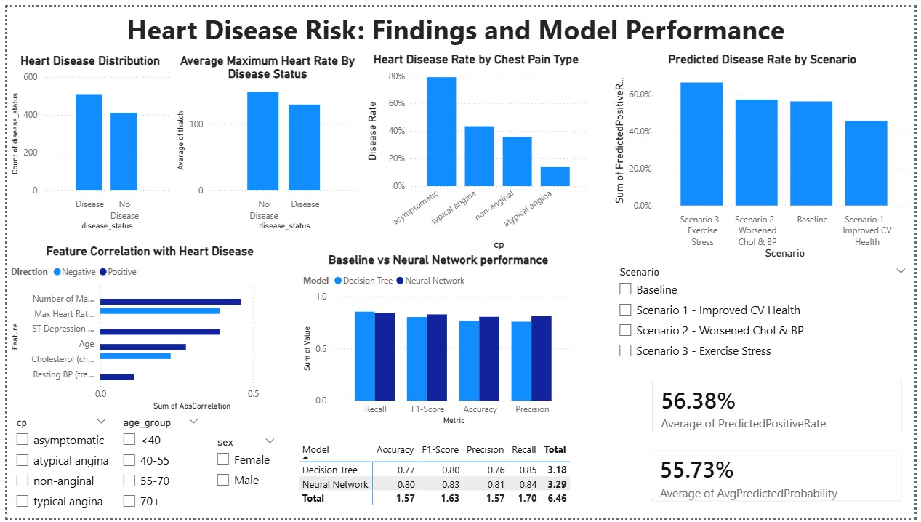
COMMUNICATION
Interactive Power BI Dashboard
Dashboard highlights
Target distribution & key EDA charts
Baseline vs neural-network comparison
New scenario comparison chart
Interactive Scenario slicer (Baseline / S1 / S2 / S3)
Filters: Sex, Age Group, Chest Pain Type
(Replace this grey box with a screenshot of your updated dashboard)
Notes:
Show the updated dashboard live. Demonstrate the Scenario slicer changing the scenario visual, and note the retained Part 4 EDA and model visuals.

Slide 12
FINDINGS
Conclusions: Answering the Questions
Which features matter most?
Exercise-induced angina, ST depression, maximum heart rate, and number of major vessels dominate; cholesterol and BP are weak alone.
Q1
Neural network vs baseline?
The neural network wins – accuracy 0.766 → 0.804 and F1 0.802 → 0.827, with better generalization.
Q2
Effect of changing inputs?
Predicted risk is highly responsive to exercise / heart-rate changes and barely responsive to cholesterol / BP alone.
Q3
Notes:
Directly answer the three research questions with the evidence gathered across all project phases.

Slide 13
RECOMMENDATIONS & TAKEAWAYS
What this project shows
The neural network is the recommended model – add early stopping / regularization to curb overfitting.
Exercise-related indicators and maximum heart rate are the most informative screening signals.
Scenario results are model sensitivity, not causation – use as decision support, not diagnosis.
Next steps: validate on broader, more representative data before any real-world use.
Thank you
Notes:
Close with recommendations: recommend the neural network with regularization, highlight the most informative features, restate the non-causal caveat, and note validation as the next step. Thank the audience and invite questions.

